Slide 1
Pipelining

Slide 2
Pipeline Performance

Slide 3
Pipeline Performance
The previous pipeline is said to have been stalled for two clock cycles.
Any condition that causes a pipeline to stall is called a hazard.
Data hazard – any condition in which either the source or the destination operands of an instruction are not available at the time expected in the pipeline. So some operation has to be delayed, and the pipeline stalls.
Instruction (control) hazard – a delay in the availability of an instruction causes the pipeline to stall.
Structural hazard – the situation when two instructions require the use of a given hardware resource at the same time.

Slide 4
Pipeline hazards
Prevent the next instruction from executing in its designated clock cycle
Reduce performance from its ideal speedup gain by pipelining
3 types of hazards
Structural – arise from resource conflicts
Data – an instruction depends on the results of the previous instruction due to overlapping in the pipeline
Control – arise from instructions that change the PC
Hazards may cause pipeline stalls (or bubbles)

Slide 5
Pipeline Hazards (2)
Hazards in pipeline can make the pipeline to stall
Eliminating a hazard often requires that some instructions in the pipeline to be allowed to proceed while others are delayed
When an instruction is stalled, instructions issued latter than the stalled instruction are stopped, while the ones issued earlier must continue
No new instructions are fetched during the stall

Slide 6
Structural hazards
Arise due to resource conflicts
Common cases
Functional units is not fully pipelined (e.g. divider)
Resource is not duplicated enough
Why designer allows them?
The reason is cost

Slide 7
Pipeline Performance
Load X(R1), R2
Structural hazard

Slide 8
Data hazards
Due to change in the order of read/write accesses to operands (in cmp with unpipelined)
Conflict could be minimized by bypassing (forwarding)
ADD r1 = r2, r3
SUB r4 = r1, r5
AND r6 = r1, r7
XOR r8 = r1, r9
Stall otherwise (by pipeline interlock logic)
LD r1 = r2, (r3)
SUB r4 = r1, r5
AND r6 = r1, r7
XOR r8 = r1, r9

Slide 9
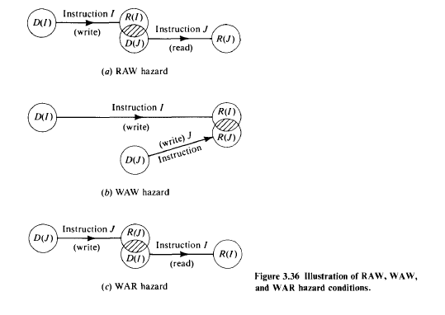

Slide 10
Data Hazards
Figure 8.6. Pipeline stalled by data dependency between D₂ and W₁.

Slide 11
Handling Data Hazards in Software
Let the compiler detect and handle the hazard:
I1: Mul R2, R3, R4
NOP
NOP
I2: Add R5, R4, R6
The compiler can reorder the instructions to perform some useful work during the NOP slots.

Slide 12
Unconditional Branches

Slide 13
Control dependencies
mul r1, r2, r3
jz zproc
:
zproc: load r1, x
:
actual path of execution depends on the outcome of multiplication
impose dependencies on the logical subsequent instructions

Slide 14
Conditional Braches
A conditional branch instruction introduces the added hazard caused by the dependency of the branch condition on the result of a preceding instruction.
The decision to branch cannot be made until the execution of that instruction has been completed.
Branch instructions represent about 20% of the dynamic instruction count of most programs.

Slide 15
Control Dependency Graph
i0
i0: r1 = op1; i1: r2 = op2; i2: r3 = op3; i3: if (r2 > r1) { i4: if (r3 > r1) { i5: r4 = r3; i6: else r4 = r1 } i7: } else r4 = r2; i8: r5 = r4 * r4;
i1
i2
i3
i4
i7
i5
i6
i8

Slide 16
Principles of designing pipeline processors
Instruction prefetch and branch handling
Data buffering and busing structures
Internal forwarding and register tagging
Hazard detection and resolution
Job Sequencing and collision prevention
Dynamic Pipelines and Reconfigurability

Slide 17
Non-Pipelined (Faster via Bit Level Parallelism (BLP))
Pipelined (ILP + BLP; 1st microprocessors RISC)
Time →
← Instrns
Time →
← Instrns

Slide 18
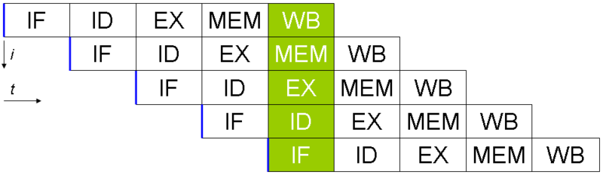
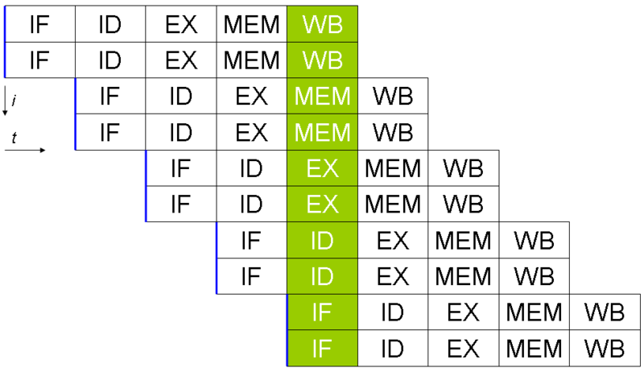
Pipelining
Superscalar

Slide 19
Advantages/Disadvantages
Advantages:
More efficient use of processor
Quicker time of execution of large number of
instructions
Disadvantages:
Pipelining involves adding hardware to the chip
Inability to continuously run the pipeline
at full speed because of pipeline hazards
which disrupt the smooth execution of the
pipeline.

